Slide 1

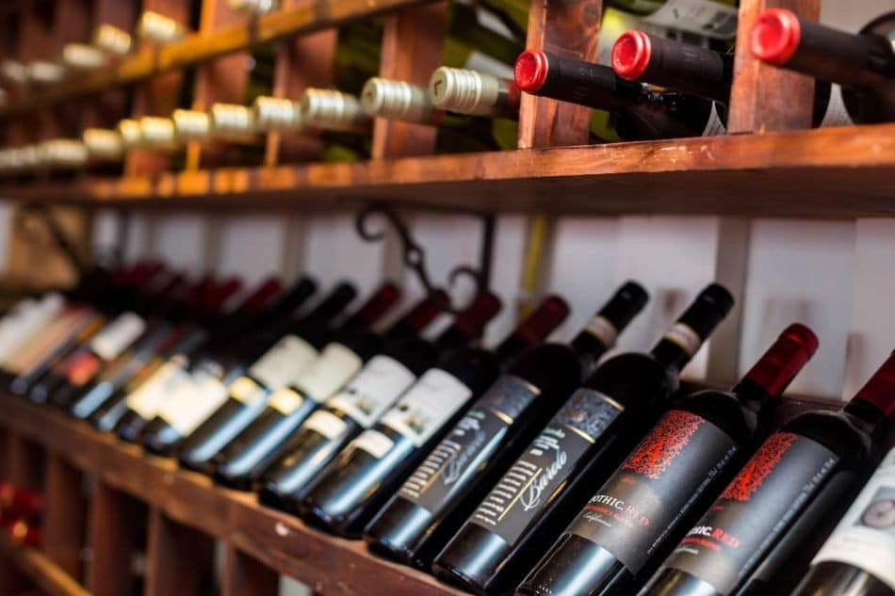
Wine Selection for a Portuguese Restaurant Case 2: Presented to Restaurant Owner
Presented by:
Madhur Kumar Garg
Yasmine Benayad
Ralph Bou-Fadel
Pratiksha Sahu

Slide 2
Agenda
Project Objective
Exploratory Data Analysis
Data Extraction & Preparation
Model Prediction
Models Comparison
Recommendations

Slide 3


Project Objective
Stakeholder
Restaurant Owner
Objectives
Provide data-based recommendations to increase business revenue by maximizing profitable wine purchase.
Compare the model performance and accuracy for selecting high-value wines.

Slide 4
Exploratory Data Analysis

Slide 5




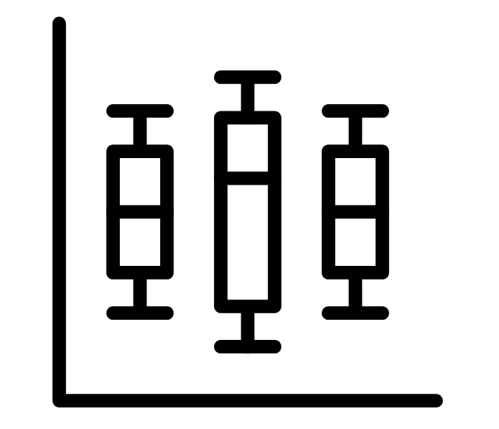
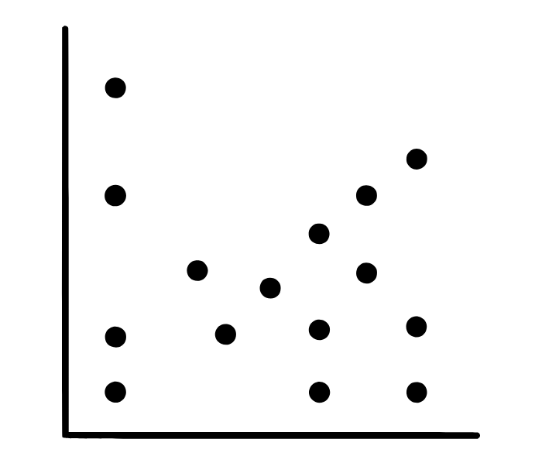

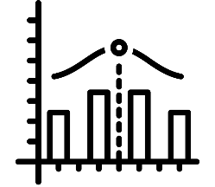



Steps in Exploratory Data Analysis ​
1
2
3
4
5
Data Collection
Gathering data from MySQL Workbench​
Data Cleaning
Handling missing values, outliers, and inconsistencies
Data Profiling
Summarizing the data to understand structure and basic statistics
Univariate Analysis
Analyzing individual variables using histograms, box plots
Bivariate Analysis
Examining relationships between pairs of variables with scatter plots, correlation matrices​
10
9
8
7
6
Insight Extraction
Drawing meaningful conclusions and insights from the data
Summary Statistics
Computing mean, median, mode, variance, standard deviation
Data Visualization
Using visual tools like bar charts, heatmaps to gain insights​
Feature Engineering Creating or transforming features to improve the dataset​
Multivariate Analysis
Exploring relationships among multiple variables using techniques like PCA

Slide 6
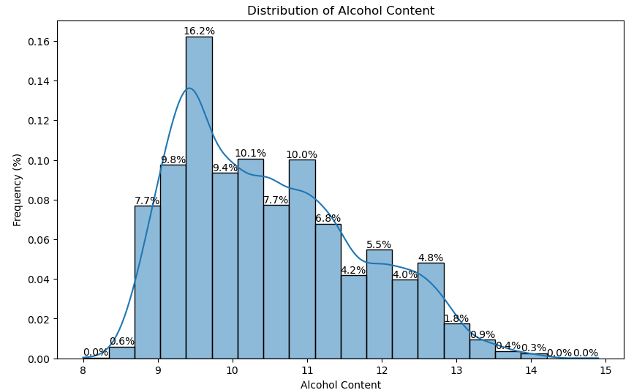
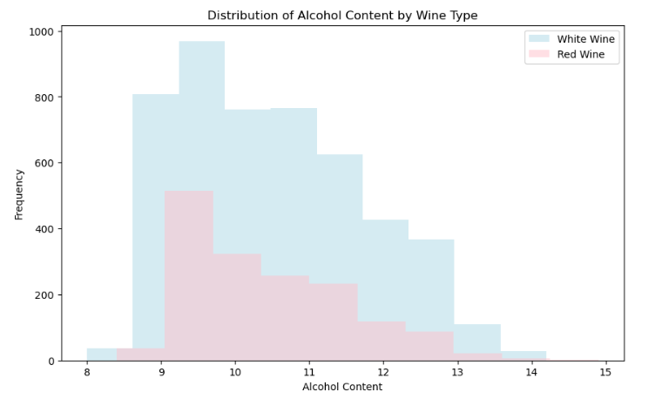
Exploratory Data Analysis (1/8)
The histogram shows a bell-shaped (normal) distribution for the alcohol content of the wines, indicating most wines have alcohol content around the central value, with fewer wines having very high or very low alcohol content.
Peaks (Mode): The highest peaks in the histogram suggest that most wines have alcohol content in the range of approximately 9-11%.
White Wine typically has lower alcohol content, clustered around 9-11%.
Red Wine, while less frequent, has a more even distribution of alcohol content ranging from 9-13%.
This suggests that White Wines tend to have lower alcohol content compared to Red Wines, which might influence the choice based on preference for lighter or fuller-bodied wines.

Slide 7
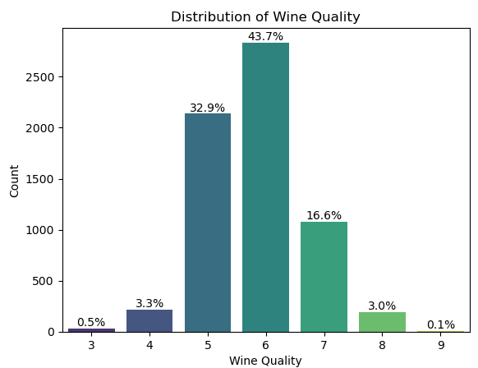
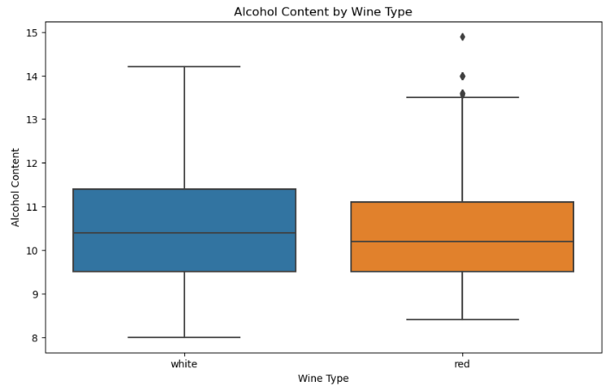
Exploratory Data Analysis (2/8)
The count plot visualizes the distribution of wine quality.
Quality 6 is the most frequent, accounting for 43.7% of the distribution.
Quality 5 follows, with 32.9%.
Quality 7 makes up 16.6%.
Other qualities like 4, 8, 3, and 9 are much less frequent.
The boxplot shows that the alcohol content for both red and white wine types is similar, slightly above 10%
Both wine types have a similar spread, as indicated by the blue and orange boxes
The whiskers for both wines is similar, extending from around 8 to 13.5% for red wines and slight above 14% for white wines
Red wine has some outliers above 13%. White wine has none.

Slide 8
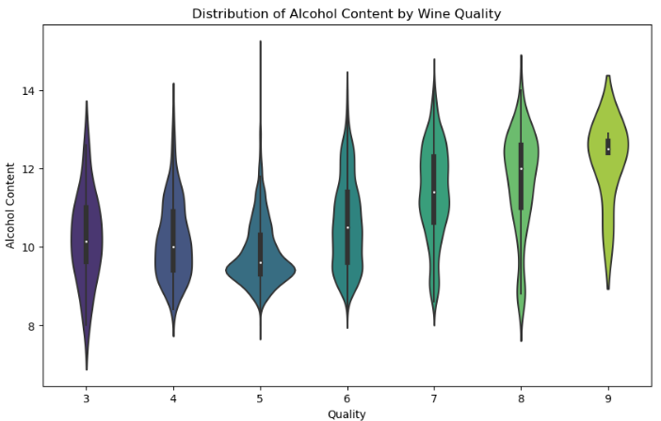
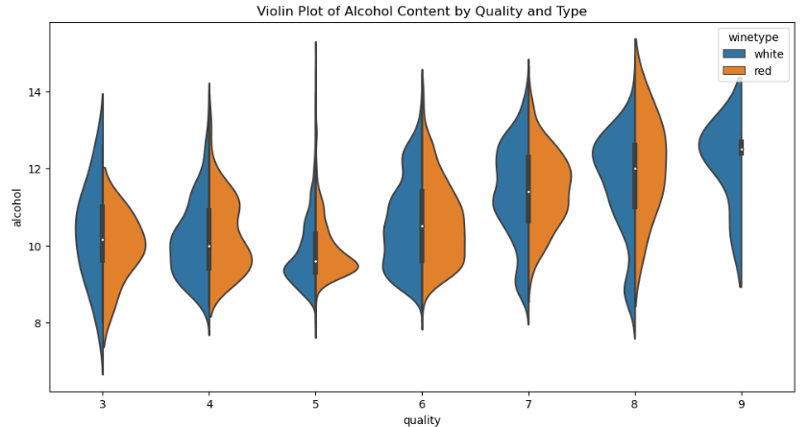
Exploratory Data Analysis (3/8)
Higher wine quality ratings (particularly 6, 7, 8, and 9) generally show higher median alcohol content compared to lower ratings (like 3, 4, and 5).
This visualization can be particularly useful for identifying not just the differences in median alcohol content among quality ratings, but also the spread and density of values.

Slide 9
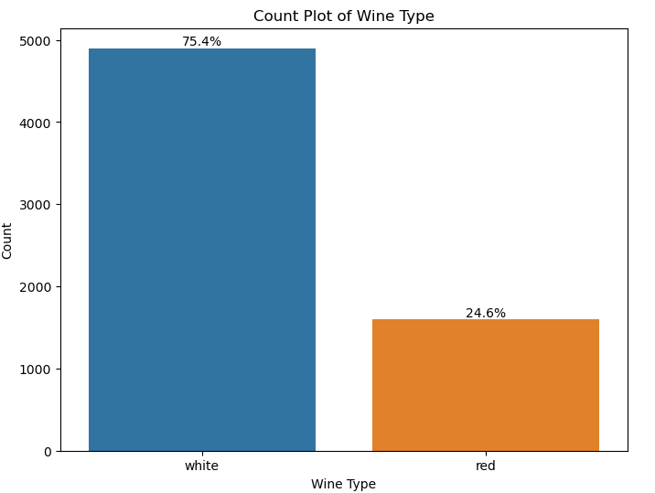
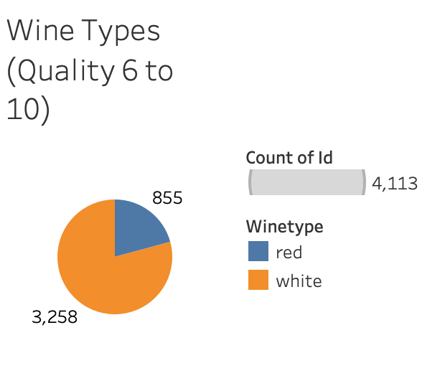
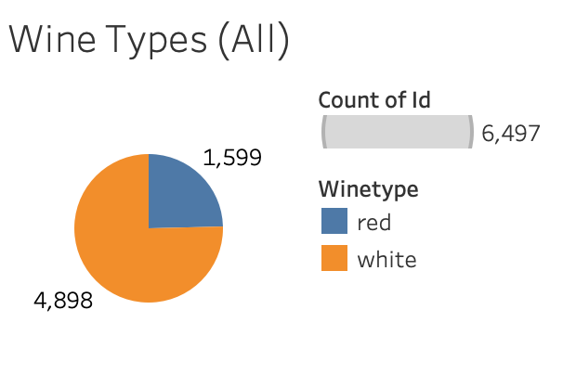
Exploratory Data Analysis (4/8)
The count plot shows the distribution of wine types:
White wine accounts for 75.4% of the dataset.
Red wine makes up 24.6%.
The pie chart visualizes the distribution of wine types:
White Wine: 4,898
Red Wine: 1,599
The pie chart visualizes the distribution of wine types of quality higher than 6:
White Wine: 3,258
Red Wine: 855

Slide 10
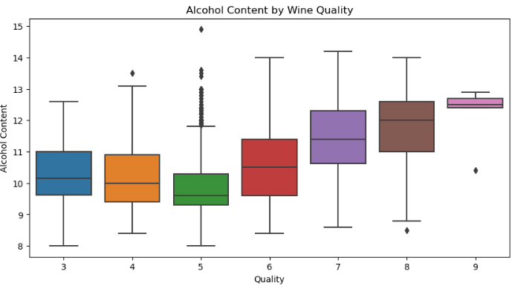
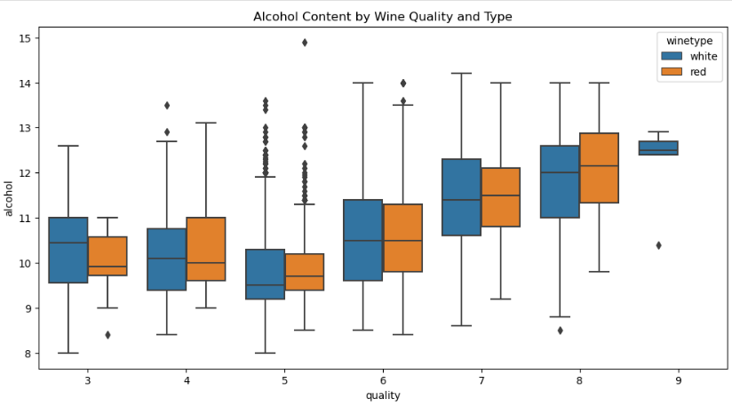
Exploratory Data Analysis (5/8)
Each box represents the interquartile range (IQR) of alcohol content for a specific wine quality, with the line inside the box indicating the median.
The whiskers extend to show the range of the data, except for points considered outliers, which are plotted as individual dots.
Higher quality wines (like 7, 8, and 9) seem to have a higher median alcohol content compared to lower quality wines (like 3 and 4).
This visualization helps identify trends and variations in alcohol content based on wine quality ratings
This chart provides insights into how wine quality correlates with alcohol content, highlighting variations between different wine types and quality levels.
Each box plot shows the distribution of alcohol content for wines of a particular quality rating. The box plots include:
The median (the horizontal line inside the box).
The quartiles (the box itself).
Any outliers (individual points outside the "whiskers").

Slide 11
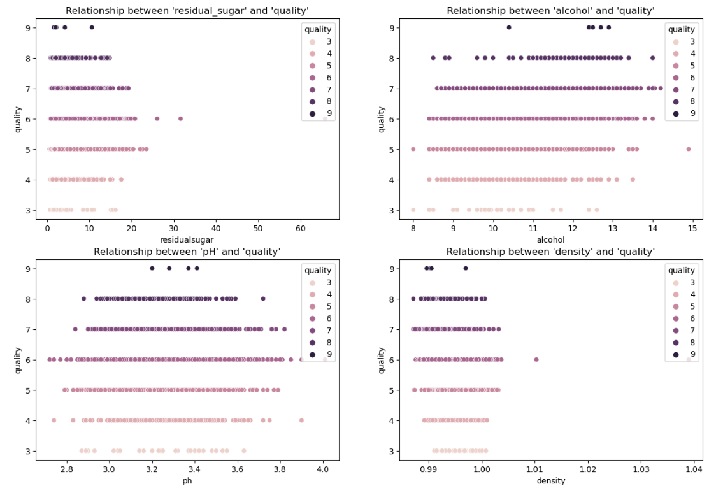
Exploratory Data Analysis (6/8)
The alcohol and density features show a more apparent positive correlation with wine quality, whereas residual sugar and pH demonstrate more variation without strong trends.

Slide 12
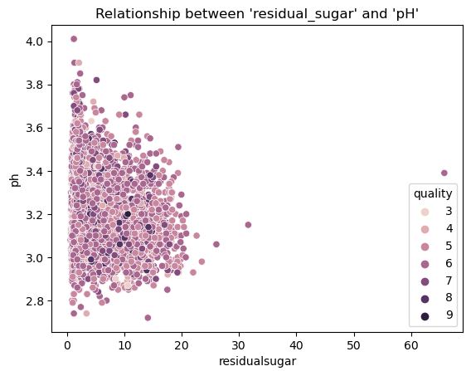
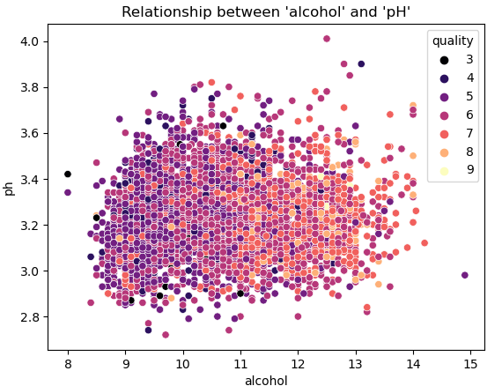
Exploratory Data Analysis (7/8)
The negative correlation suggests that as residual sugar increases, pH decreases, potentially affecting wine taste and freshness.
Quality scores appear to cluster more around lower residual sugar levels, suggesting that excessive sweetness may not always correlate with high-quality ratings.
While there’s a slight correlation suggesting that higher alcohol content could be associated with higher pH, other factors may influence wine quality more directly, as there is considerable overlap among quality ratings.
This analysis can guide further investigations into how pH and alcohol content interact with other factors influencing wine quality

Slide 13
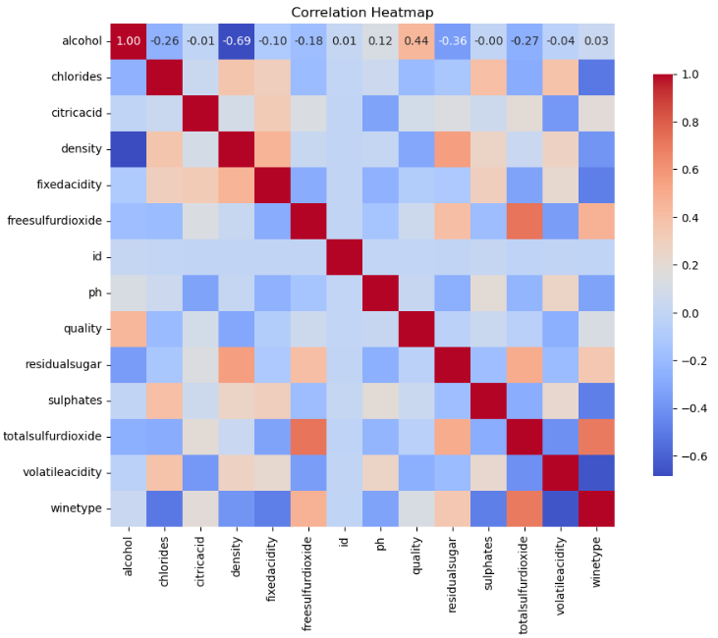
Exploratory Data Analysis (8/8)
Blue indicates a negative correlation
Red indicates a positive correlation
The intensity of the color represents the strength of the correlation
Perfect Correlation: The diagonal from the top left to the bottom right is dark red, indicating a perfect correlation of 1.00 for each variable with itself.
Positive Correlations: Variables that have strong positive correlations are shown in shades of red. For example, if Alcohol and Quality show a bright red color, it indicates a strong positive relationship.
Negative Correlations: Variables that have strong negative correlations are shown in shades of blue. For instance, if Density and Alcohol appear blue, it suggests a negative relationship.

Slide 14



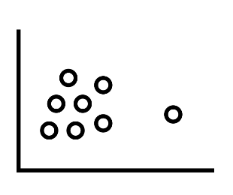
Exploratory Data Analysis: Identifying Outliers (1/2)
Identifying outliers is like spotting the unusual ones in a crowd
Visualization Method
Create charts like scatter plots and box plots to visually detect any points that are far removed from the majority
Tools
Python and Jupyter Notebook were used for data visualization
Libraries
Identify outliers using Python libraries like matplotlib and seaborn

Slide 15
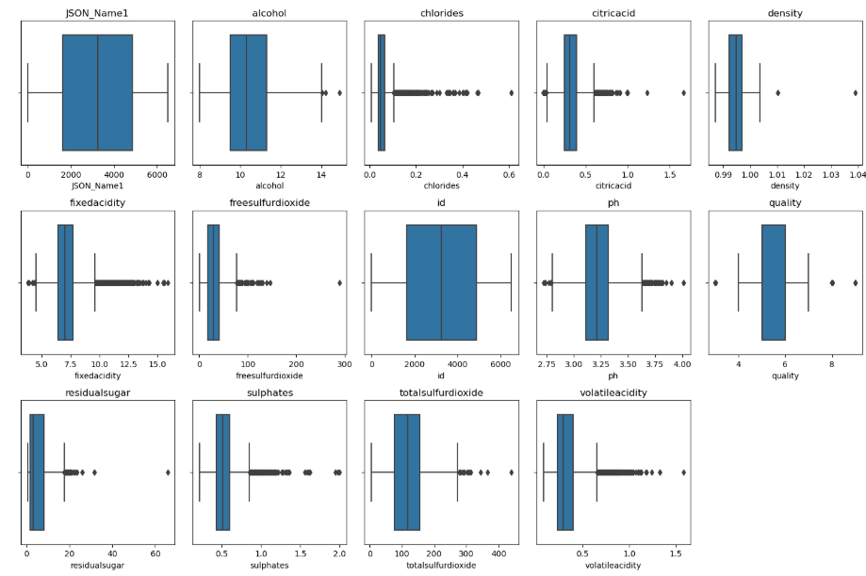
Exploratory Data Analysis: Identifying Outliers (2/2)
Some wines exhibit unusually high or low alcohol levels.
Elevated chlorides levels may impact taste.
Elevated citric acid levels may sharpen taste.
Higher fixed acidity levels may indicate stability, possibly impacting taste.
Variability in free SO₂ levels affects preservation.
A few wines have pH levels outside the range.
Presence of sweeter wines with higher residual sugar.
Higher sulphates levels can enhance flavor complexity.
Higher total SO₂ levels prevent oxidation.
Higher volatile acidity levels can negatively affect flavor, making it vinegary.
Some wines have elevated total acidity levels.
A few wines have exceptionally high- or low- quality ratings.
Higher density may indicate higher sugar content.

Slide 16




Outliers Removal Method: Interquartile Range (IQR)
Steps in the IQR Method for Outlier Detection
1
Calculate Quartiles
Q1 (First Quartile): This is the 25th percentile of the data. It marks the point below which 25% of the data falls.
Q3 (Third Quartile): This is the 75th percentile of the data. It marks the point below which 75% of the data falls.
2
Interquartile Range
The Interquartile Range (IQR) is a measure of statistical dispersion and is calculated as the difference between the third quartile (Q3) and the first quartile (Q1) in a dataset. It represents the range within which the middle 50% of values lie.
Compute the IQR
IQR = Q3 - Q1
This tells you the range of the middle 50% of the data
3
Determine Outlier Boundaries
Lower Bound: Calculated as
( Q1 - 1.5 \times \text{IQR} )
Upper Bound: Calculated as
( Q3 + 1.5 \times \text{IQR} )
Values falling below the lower bound or above the upper bound are considered outliers.
4
Filter Outliers
Remove any data points that fall outside these bounds to get a cleaned dataset.

Slide 17
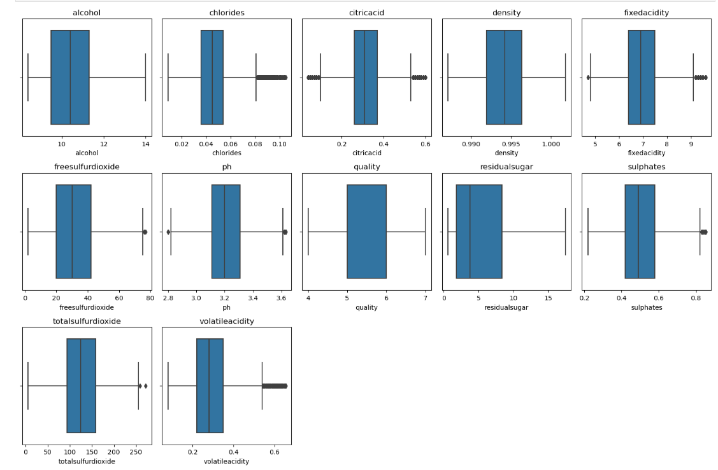
Exploratory Data Analysis: After Removing Outliers (1/3)

Slide 18
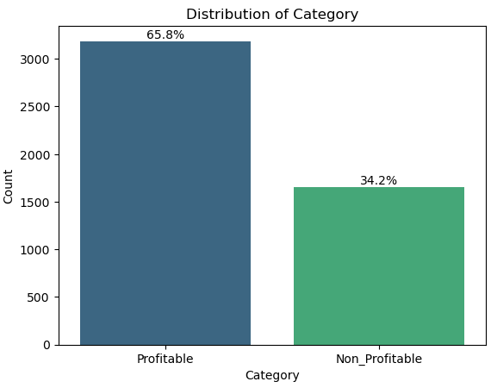
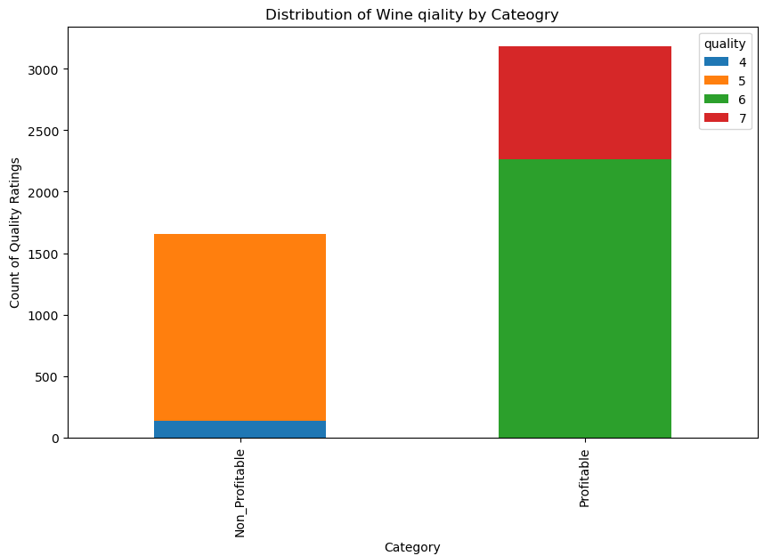
Exploratory Data Analysis: After Removing Outliers (2/3)
Approximately 65.8% of the wines are categorized as Profitable.
About 34.2% of the wines are labeled as Non-Profitable.
The Profitable category shows a balanced distribution of quality ratings, particularly higher ratings (e.g., 6 and 7).
The Non-Profitable wines appear to have a more limited range of quality ratings, with lower counts focused on quality ratings 4 & 5.
There appears to be a potential link between wine quality and profitability; higher quality ratings may lead to better sales and profitability.

Slide 19
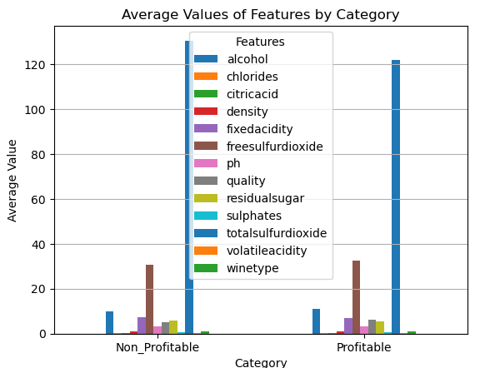
Exploratory Data Analysis: After Removing Outliers (3/3)
Alcohol Content
Profitable wines tend to have a higher average alcohol content compared to Non-Profitable wines.
Alcohol levels could be a significant factor contributing to profitability.
Sulphates and Acidity
Features like sulphates and acidity levels differ between the categories, although these differences are subtler.
These components, influencing taste and preservation, might impact consumer preference and profitability.
Residual Sugar and Density
Variations in residual sugar and density can affect the sweetness and body of the wine, potentially influencing market demand.
Total Sulfur Dioxide
Differences in sulfur dioxide content suggest variations in wine preservation methods between profitable and less profitable wines.

Slide 20















Dataset Summary
Target Variable
Predictor Variables
Category
Used for building the models
ID
Unique record identifier
Fixed Acidity g/dm³
Influences the wine's taste and stability
Volatile Acidity g/dm³
Affects taste; high values can lead to vinegar-like flavors
Citric Acid g/dm³
Contributes to freshness and flavor in small quantities
Residual Sugar g/dm³
The amount of sugar left after fermentation
Chlorides g/dm³
Indicates the salt content in the wine
Free Sulfur Dioxide
Protects against microbial growth and oxidation
Total sulfur dioxide g/dm³
Includes both free and bound forms
Density g/cm³
Related to alcohol and sugar content
pH
Scale from 0 to 14, indicating acidity or basicity
Sulphates g/dm³
Added for antimicrobial and antioxidant properties
Alcohol
Percentage of alcohol content
Quality Score (0-10)
0 very bad; 10 excellent
based on sensory evaluators assessment
Profitability
Quality Score <6 deemed unprofitable; based on owner’s experience

Slide 21
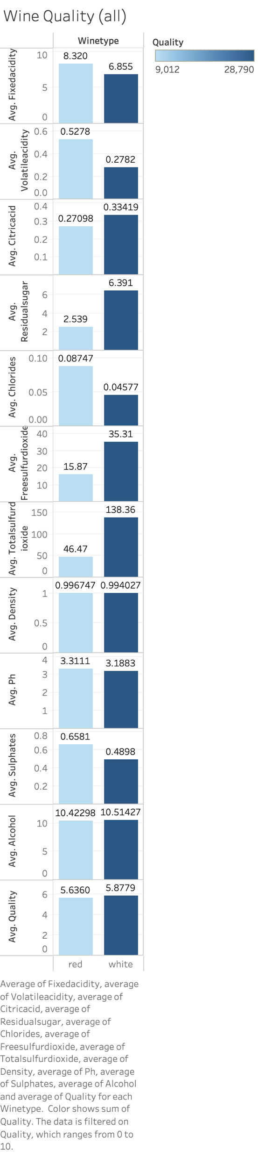
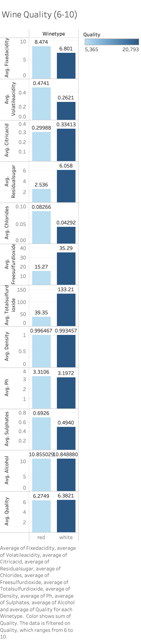
Dataset Analysis (1/4)
The dataset aims to develop a predictive model to assist in selecting wines that enhance customer satisfaction and profitability for the restaurant, based on the technical characteristics of the wines.
After removing all wines with quality score less than 6:
Average fixed acidity of red wines increases by 0.154 but decreases by 0.054 for white wines.
Average volatile acidity decreases by 0.0537 for red wines and by 0.0161 for white wines.
Average citric acid increases by 0.0289 for red wines and 0.00006 for white wines (remains stable).

Slide 22
Dataset Analysis (2/4)
After removing all wines with quality score less than 6:
Average residual sugar of red wines decreases by 0.003 (almost stable) and 0.333 for white wines.
Average chlorides decrease by 0.00481 for red wines and by 0.00285 for white wines.
Average free sulfur dioxide decreases by 0.6 for red wines and by 0.02 for white wines.

Slide 23
Dataset Analysis (3/4)
After removing all wines with quality score less than 6:
Average total sulfur dioxide of red wines decreases by 7.12 and 5.15 for white wines.
Average density decrease by 0.00028 for red wines and by 0.00057 for white wines, remaining stable for both wine types.
Average pH decreases by 0.0005 for red wines (becoming more acidic) but increases by 0.0089 for white wines (becoming less acidic).

Slide 24
Dataset Analysis (4/4)
After removing all wines with quality score less than 6:
Average sulphates of red wines increases by 0.0345 and by 0.0042 for white wines.
Average alcohol increases by 0.432049 for red wines and by 0.33461 for white wines, remaining stable for both wine types.
Average Quality increases by 0.6389 for red wines and 0.5042 for white wines.

Slide 25
Data Extraction & Preparation

Slide 26
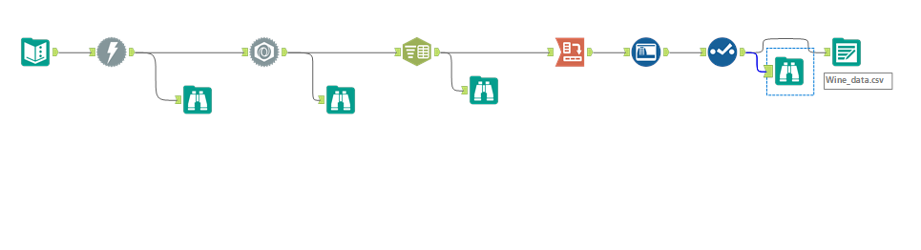
Data Extraction
Notes:
About data Extraction workflow:
The technical data was collected using a computerized system (iLab) from May 2004 to February 2007.
Text input tool allows to enter text to create small data files.
Download tool was used to retrieve data from the URL (https://sheetlabs.com/DA/winequality.)
JSON Parse tool converts data into a table schema (Output value in string fields)
Text to Columns tool takes data in the text in 1 column and splits string value into multiple column based on delimiter.
Cross tab tool changes the orientation of data from vertical data fields onto a horizontal axis and summarizing data where needed.

Slide 27
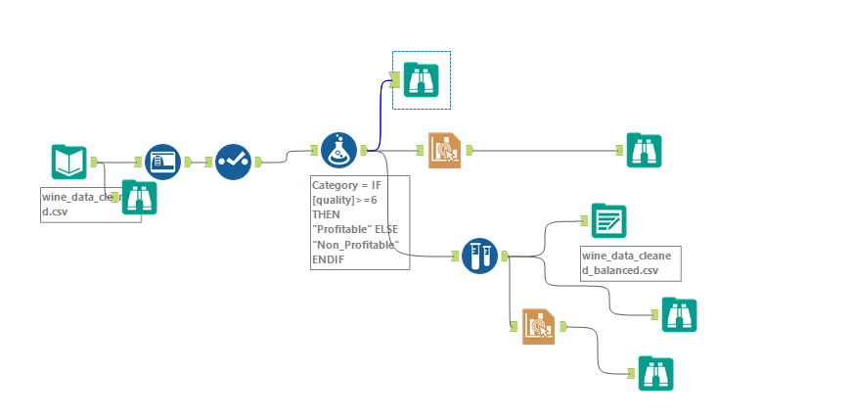
Data Preparation and Balancing Workflow
Notes:
After Data extraction, data cleaning and outliers detection was done (During EDA step by Yasmine) and cleaned data file was used in this workflow.
Data was categorized based on quality score, so the wines with a quality score below 6 was labelled as non_profitable and 6 and above was labelled as profitable.
However, data was unbalanced (Profitable: 3000 & non_profitable: 1500 approx) , hence oversample tool was used with field set as Category, field value as Non_Profitable & percentage as 50%)
Bar graphs were used to compare the fields (Profitable and Non_Profitable)

Slide 28
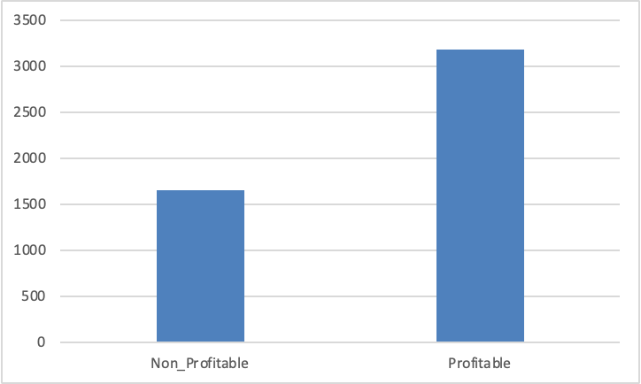
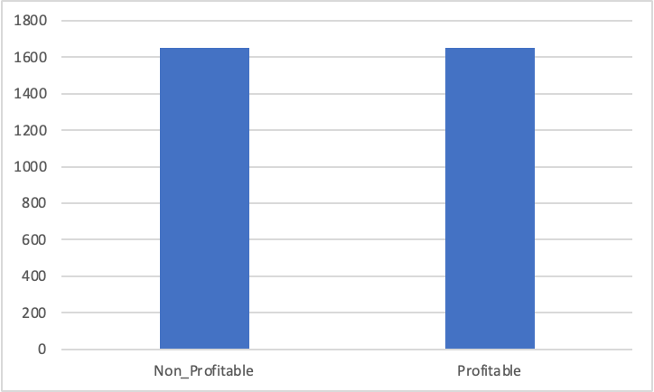
Data Balancing
Unbalanced Dataset
Balanced Dataset
Notes:
In this slide it can be seen that unbalanced dataset shows profitable class to be almost double of Non_profitable classs. When a dataset is imbalanced, the model can although show a high accuracy but fails to correctly classify minority class (in this case Non_Profitable). Model can become biased towards majority class (Profitable class).
Hence dataset was balanced to reduce the chances of model overfitting and to build a optimized, unbiased model.

Slide 29
Models Prediction

Slide 30
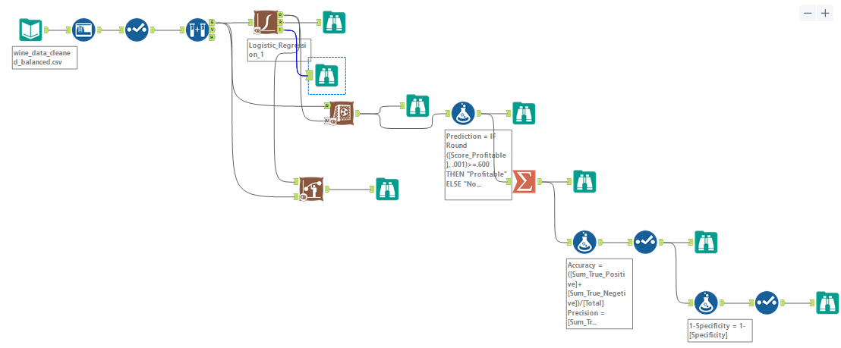
Models Prediction: Logistic Regression Model (1/2)
Notes:
Data was divided in 70% Estimation and 30% as validation
Estimation data was used to build logistic regression model with target variable as Category and all other variables as prediction variable except citric acid, chlorides (no statistical significance ) and quality (similar to category)
Model was checked on 2 other threshold values i.e 0.4 and 0.6 and parameters like Accuracy, precision, recall, specificity and F1 score was calculated.

Slide 31
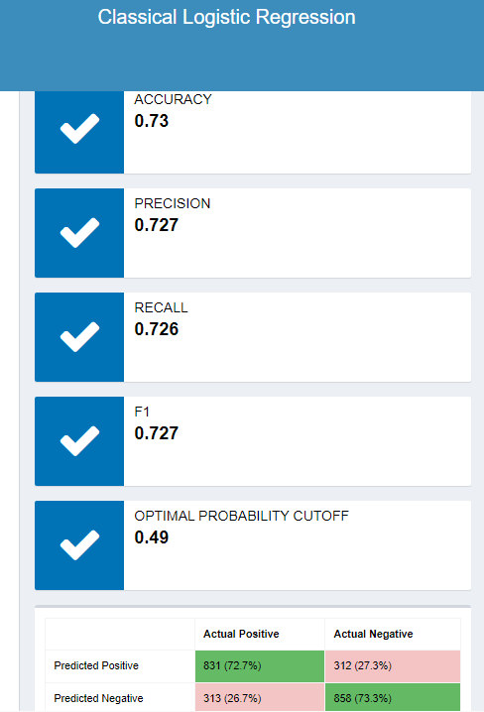
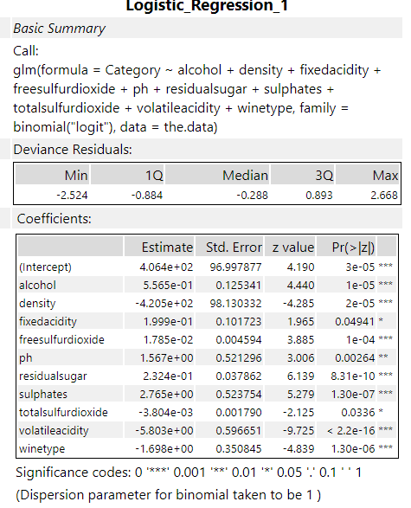
Models Prediction: Logistic Regression Model (2/2)
Threshold Value | 0.6 | 0.4
Accuracy | 0.71 | 0.72
Precision | 0.59 | 0.82
Recall | 0.77 | 0.68
F1 score | 0.67 | 0.74
Specificity | 0.68 | 0.78
1-Specificity | 0.32 | 0.21
Notes:
Accuracy is how well model is correctly classifying positive and negative class out of all instances classified.
Precision is the measure the accuracy of positive predictions (Out of all predicted positives, how many were actually positive)
Recall the ability to identify all actual positives
F1 score is the balance b/w Precision and recall
Specificity is the measure of correctly classifying negatives.

Slide 32
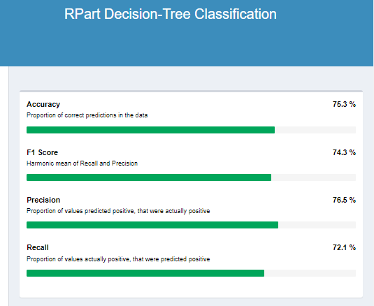
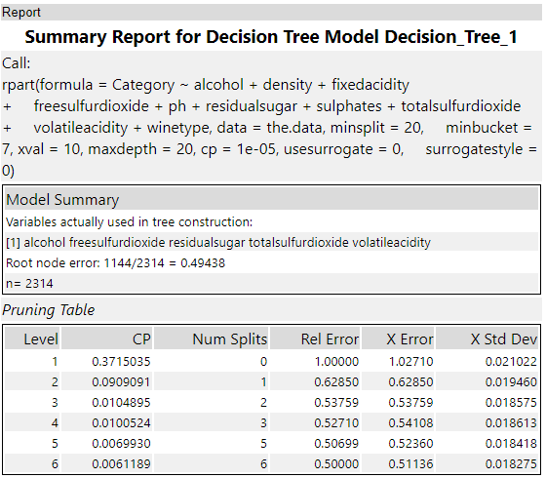
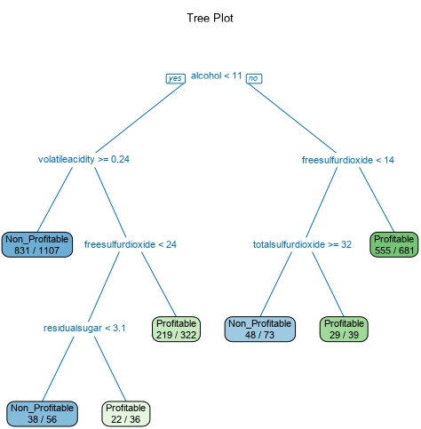
Models Prediction: Decision Tree Model
Notes:
A tree plot shows how decision was made based on features and each node represents outcome of the decision.

Slide 33
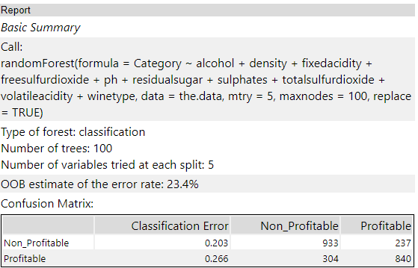
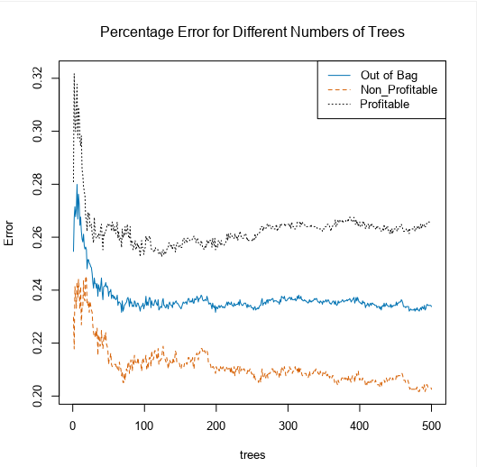
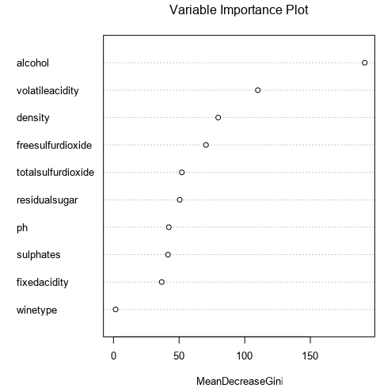
Models Prediction: Random Forest Model
Notes:
The Percentage error chart shows that after around 100 tree, error rate don't show a significant improvement, hence we kept number of trees as 100 and maximum dept of tree at 5 to reduce overfitting problem.
Depth of tree means how many decision or splits a tree makes before arriving at a decision. (In case of overfitting the model tends to memorizer data including noise).
Mean Decrease in GINI is how much each feature helps in reducing decision tree splits. feature that give better separation (reduces entropy or gini) have more importance.

Slide 34
Models Comparison

Slide 35
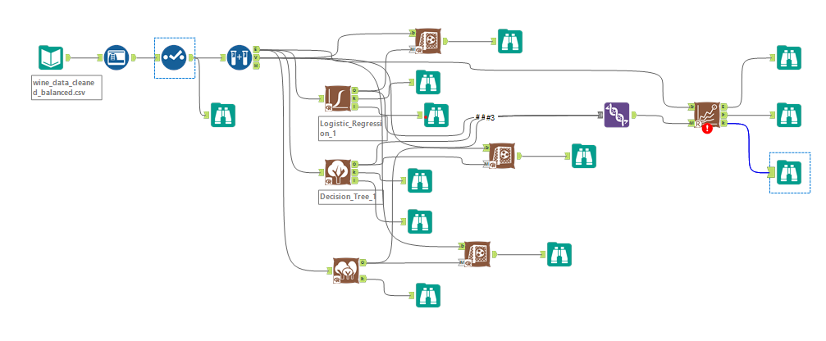
Models Comparison: Workflow

Slide 36
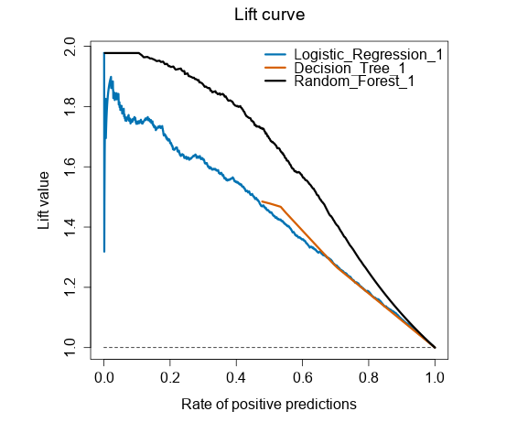
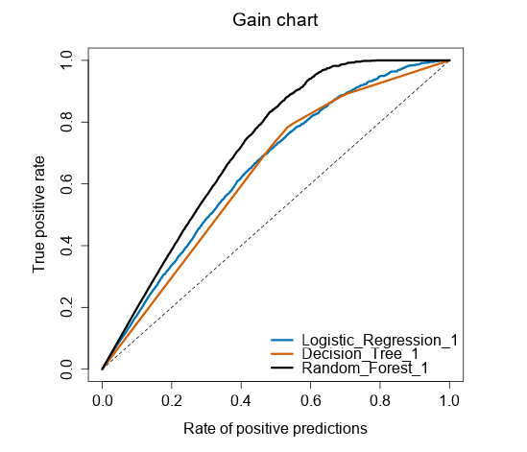
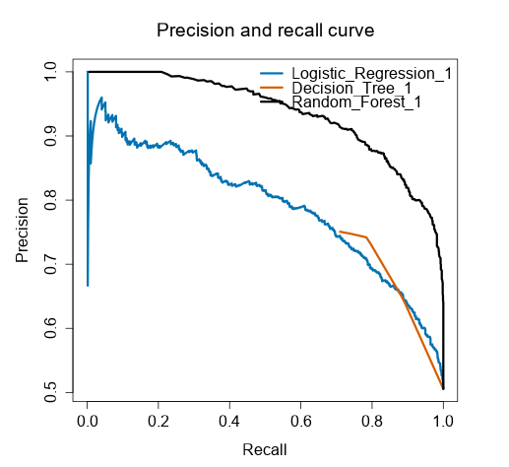
Models Comparison: Diagnostic Plots
Notes:
Lift curve shows how well model can predict positive class (Profitable) compared to random chances. (Lift >1, the model is better than random guessing, Lift=1, no better than random. Lift< 1, worse than random)
Gain Chart shows the True positive rate for different percentage of positive predictions.
The curve shows tradeoff between precision and recall for different thresholds for classification model.

Slide 37
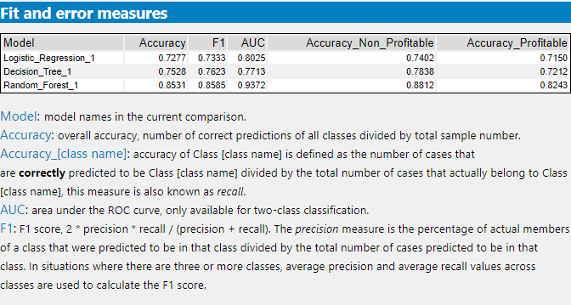
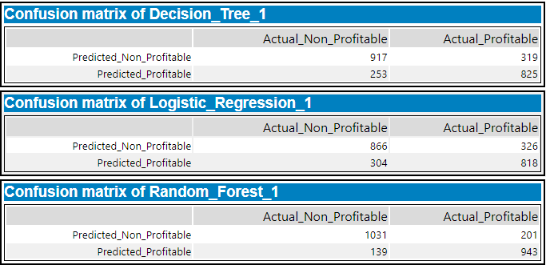
Models Comparison: Report

Slide 38
Best Performance Model
Parameters | Logistic Regression | Decision Tree | Random Forest
Accuracy | 0.73 | 0.75 | 0.85
Precision | 0.73 | 0.77 | 0.87
Recall | 0.72 | 0.72 | 0.82
Specificity | 0.73 | 0.78 | 0.88
F1 Score | 0.72 | 0.75 | 0.86
Accuracy: Random Forest achieved the highest accuracy (0.85), indicating it performed best overall in correctly classifying wines.
Precision: Random Forest also excelled in precision (0.87), meaning that when it predicts a wine type, it is most likely correct.
Recall: The Random Forest model has the highest recall (0.82), showing it effectively captures a higher proportion of actual positive cases.
Specificity: This model also leads in specificity (0.88), indicating it has the best ability to identify true negatives.
F1 Score: The F1 score (0.86) for Random Forest is significantly better, reflecting a good balance between precision and recall.
Overall, the Random Forest model outperforms the other two models across all metrics, suggesting it is the most suitable choice for predicting wine quality.
Conclusion: Based on all parameters Random Forest is the best model for profitable wines selection to maximize revenue.

Slide 39
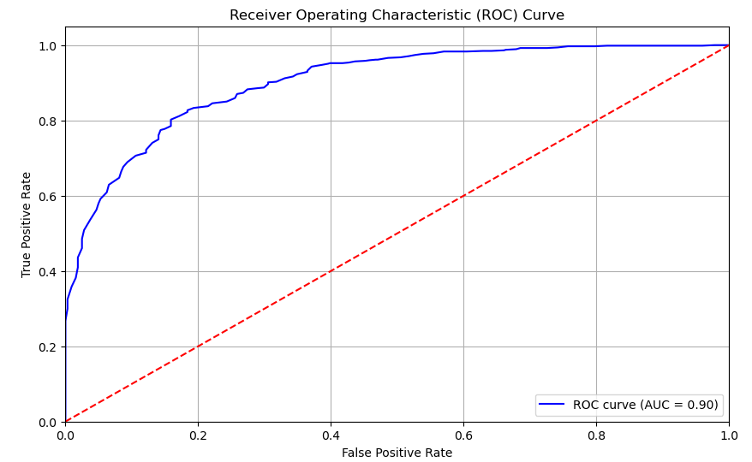
ROC Curve (Random Forest)
Curve Shape
The curve itself shows the performance of the model at various threshold settings.
A curve closer to the top-left corner indicates better performance, meaning the model has a high true positive rate while maintaining a low false positive rate.
Area Under the Curve (AUC)
The area under the ROC curve (AUC) is a single scalar value that summarizes the performance of the model.
An AUC of 0.90 suggests that the model is excellent at distinguishing between the two classes (Profitable vs. Non-Profitable).
Diagonal Line (Red Dashed Line)
The red dashed line represents the "no discrimination" line, which would indicate that the model has no ability to distinguish between the positive and negative classes. Essentially, it reflects random guessing.

Slide 40
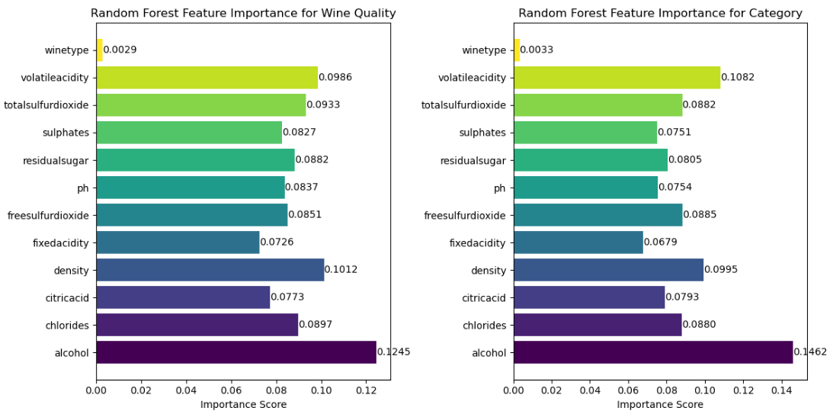
Random Forest Model: Features Importances (1/2)
Importance for Wine Quality
Alcohol: With the highest importance score (0.1245), alcohol content is likely a significant predictor of wine quality. Higher alcohol levels often indicate better fermentation processes and may correlate with overall quality.
Volatile Acidity: The second most important feature (0.0968), volatile acidity indicates the level of acetic acid in wine. Lower levels are generally preferred for higher quality.
Total Sulfur Dioxide: Plays a role in preservation; too much sulfur can affect taste, making it a relevant factor for quality (0.0837).
Residual Sugar and pH: These features are also quite significant (0.0790 and 0.0754, respectively), where balanced sugar and pH levels contribute to a more pleasant tasting experience.

Slide 41
Random Forest Model: Features Importances (2/2)
Importance for Category (Profitable vs. Non-Profitable)
Volatile Acidity: The most important feature for category classification (0.1082) suggests that this factor might differentiate between profitable and non-profitable wines effectively.
Wine Type: With a score of 0.0033, it suggests that the type of wine (e.g., red or white) might have less influence than other chemical attributes.
Other Chemical Features: Features like sulphates (0.0822) and residual sugar (0.0842) also play significant roles, indicating that certain chemical compositions can affect profitability.

Slide 42
Recommendations

Slide 43




Recommendations (1/4)
Focus on High Impact Features
Prioritize wines with higher levels of Total Sulfur Dioxide and Residual Sugar, as these factors significantly contribute to higher quality ratings.
Select Quality Wines
Recommend stocking more wines that scored 6 or above on the quality scale, as these are more profitable and align with the owner's experience regarding storage requirements.
Diverse Offerings
Create a balanced selection of both red and white wines, focusing on those with quality scores of 6-10 to cater to a variety of customer preferences.
Quality Testing
Implement regular quality testing and evaluations of new wines to ensure they meet the desired standards for total sulfur dioxide and residual sugar levels.

Slide 44




Recommendations (2/4)
Educate Staff
Invest in staff training to ensure that they can confidently discuss wine options. Knowledgeable staff can greatly influence customers' selections and enhance their dining experience
Market Positioning
Highlight wines with exemplary quality scores in the menu, perhaps through a “Featured Wine of the Month” section, to draw attention to high-quality offerings.
Feedback Loop
Utilize customer feedback to adjust wine offerings. Identify which wines are popular and correlate them with their characteristics. This feedback can inform future selections and training for staff.
Data-driven Decisions
Continuously monitor sales data and customer feedback to assess which wines perform best and adjust stock levels accordingly.

Slide 45




Recommendations (3/4)
Focus on Quality
Prioritize wines with higher alcohol content and lower volatile acidity, as these attributes are linked with higher quality ratings. Quality wines can enhance the dining experience and encourage repeat customers.
Variety of Options
Offer a mix of profitable and high-quality wines. While quality is crucial, it’s also important to provide options that appeal to different customer preferences and budgets. This can include both high-quality wines and those that are well-priced.
Highlight Signature Wines
Identify and promote wines with high importance scores that reflect the restaurant's character, such as locally produced wines or those with unique flavor profiles. This can create a distinct style for the restaurant's wine offerings.
Pairing Suggestions
Train staff to make wine recommendations based on menu items. Understanding how different wines complement various dishes can enhance customer satisfaction and increase sales.

Slide 46




Recommendations (4/4)
Pricing Strategy
Consider pricing wines competitively while maintaining quality. Customers are often willing to pay more for higher quality. However, we need to ensure that profit margins remain healthy.
Seasonal Selection
Adjust the wine list seasonally to reflect changing customer preferences. For example, lighter wines in summer and fuller-bodied reds in winter could improve sales during different times of the year.
Monitor Inventory for Promotions
Keep an eye on inventory turnover for each wine. If certain high-quality or profitable wines are not selling, consider reasonable discounts or promotions to clear stock.
Wine Events
Host wine tasting events to introduce customers to high-quality and unique wine selections. This not only promotes specific wines but also creates a social experience that can attract more patrons.

Slide 47
Thank You

